Slide 1

Explainable AI (XAI)
Explaining the predictions of any classifier

Slide 2
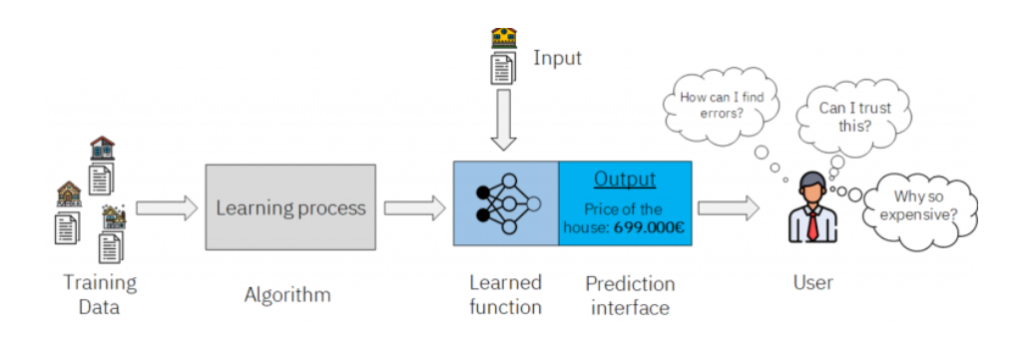
How can I trust the predictions of my model?

Slide 3
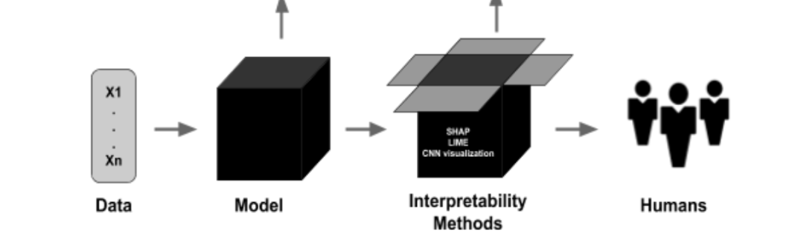
What is XAI?
Explainable AI(XAI) refers to the set of methods that allows humans to understand and trust the results created by machine learning algorithms.

Slide 4
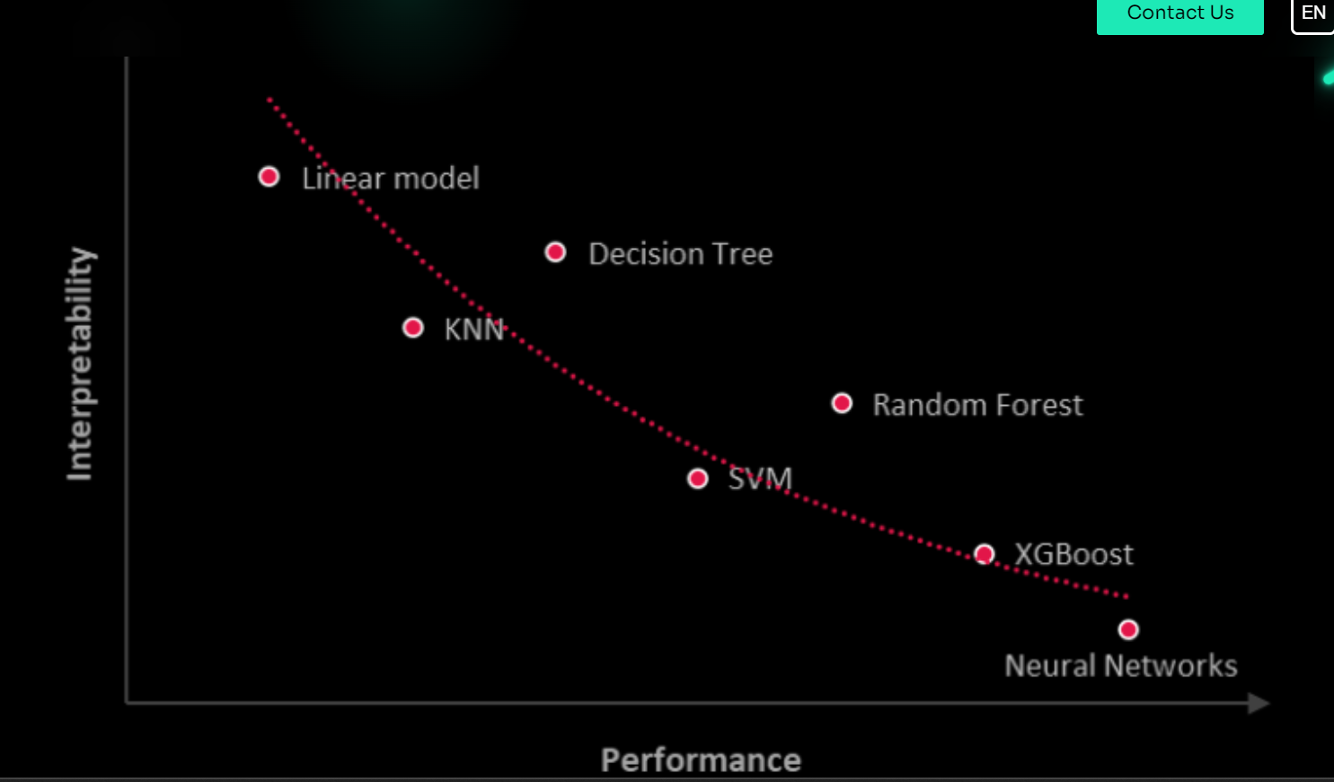
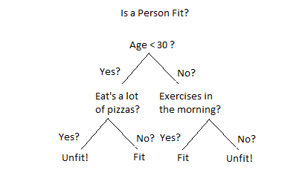
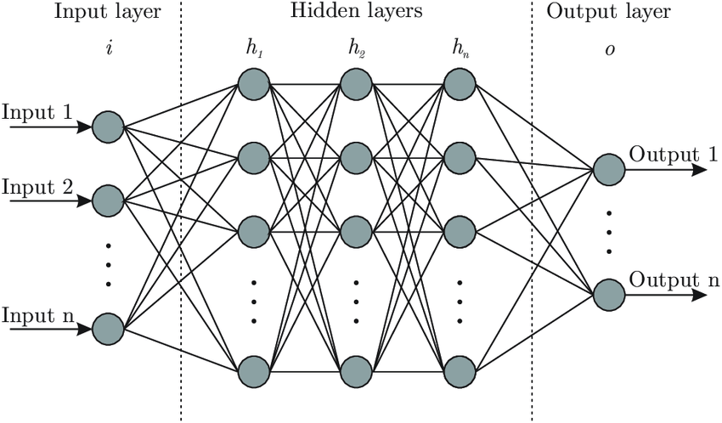
Lack of Interpretability and performance according to the type of the model:

Slide 5
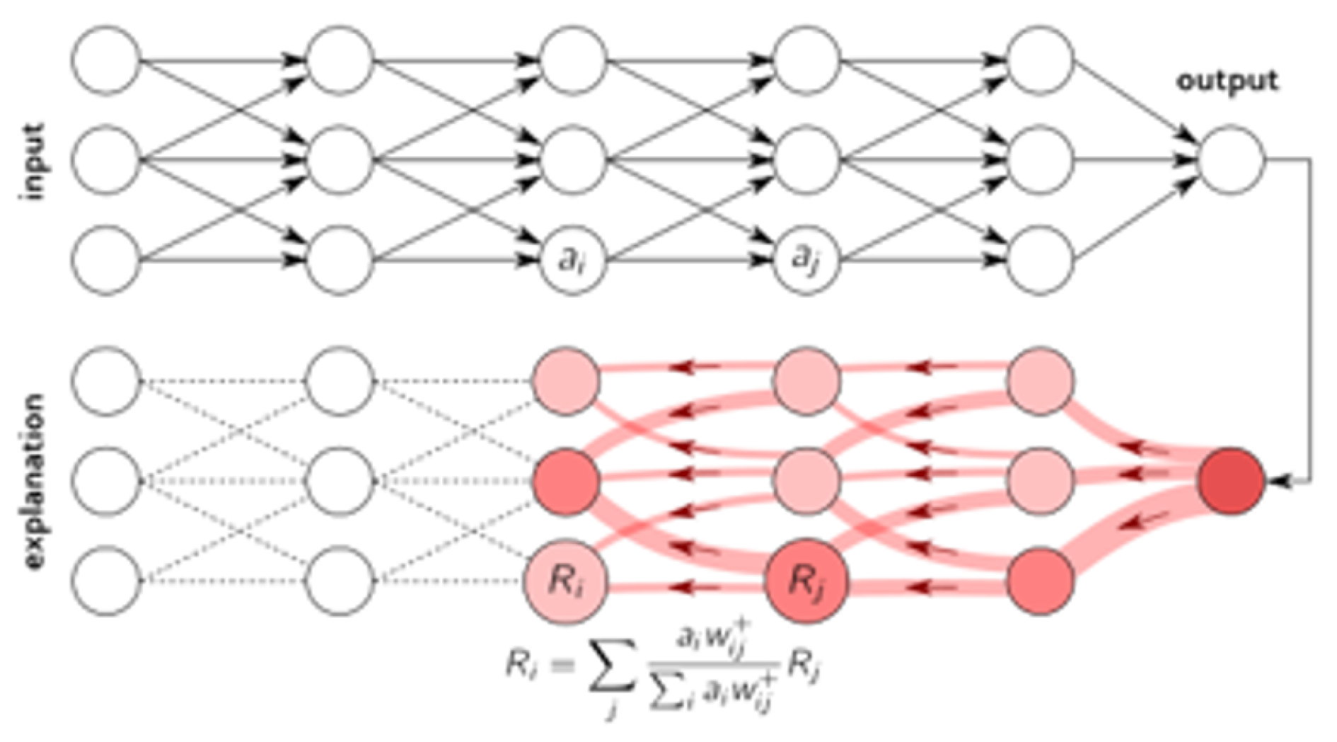
1. Layer-wise Relevance Propagation (LRP)
LRP operates by propagating the prediction f(x) backwards in the neural network, by means of purposely designed local propagation rules.
The propagation procedure implemented by LRP is subject to a conservation property,
where what has been received by a neuron must be redistributed to the lower layer in equal amount.

Slide 6
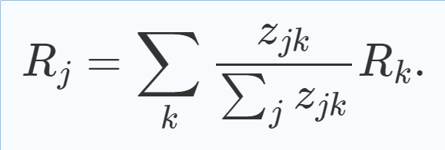
1. Layer-wise Relevance Propagation (LRP)
Let j and k be neurons at two consecutive layers of the neural network. Propagating relevance scores
(Rk)k at a given layer onto neurons of the lower layer is achieved by applying the rule:
The quantity Zjk models the extent to which neuron j has contributed to make neuron k relevant.
The denominator serves to enforce the conservation property.
The propagation procedure terminates once the input features have been reached.

Slide 7

2. SHAP SHapley Additive exPlanations
By considering all potential feature combinations and their contributions, SHAP calculates the Shapley values for each feature.
The fundamental idea behind SHAP is to use the Shapley values to determine the relative contributions of each input feature to the final output after attributing the prediction of a model to various input features.

Slide 8
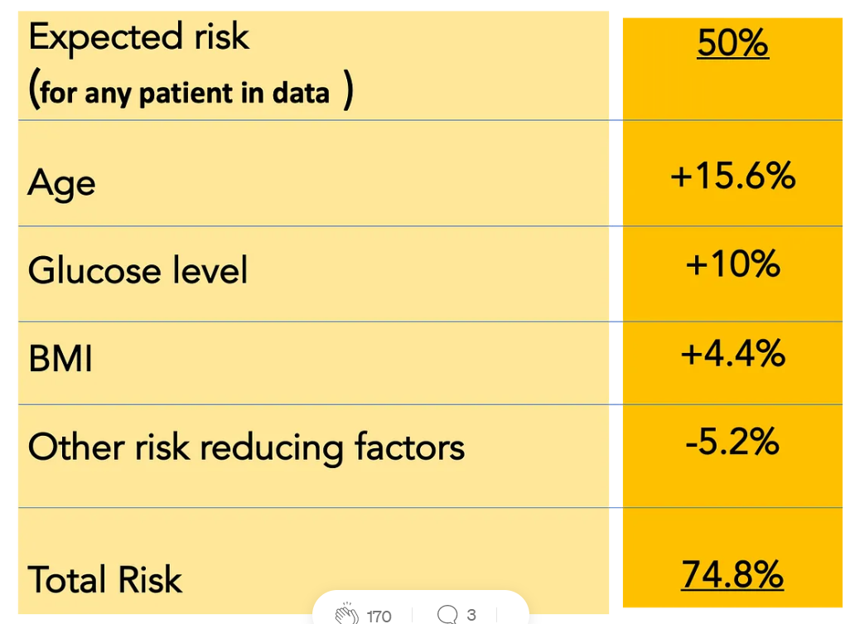
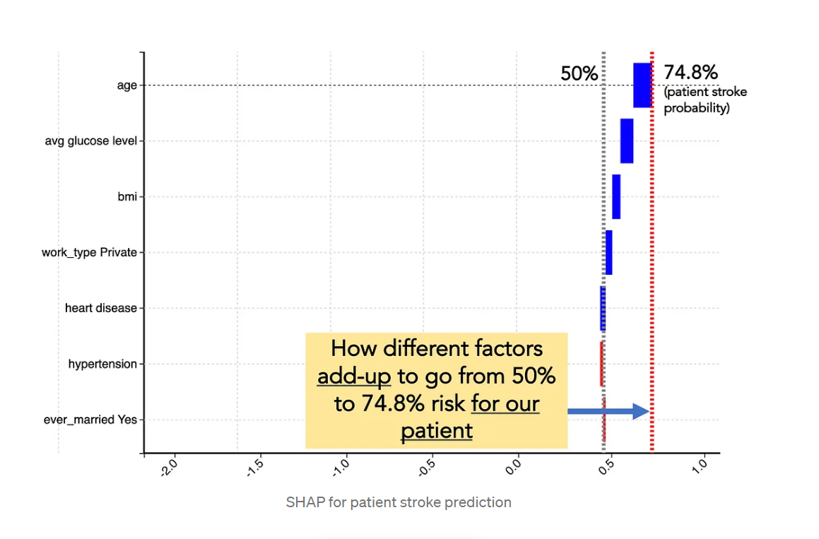
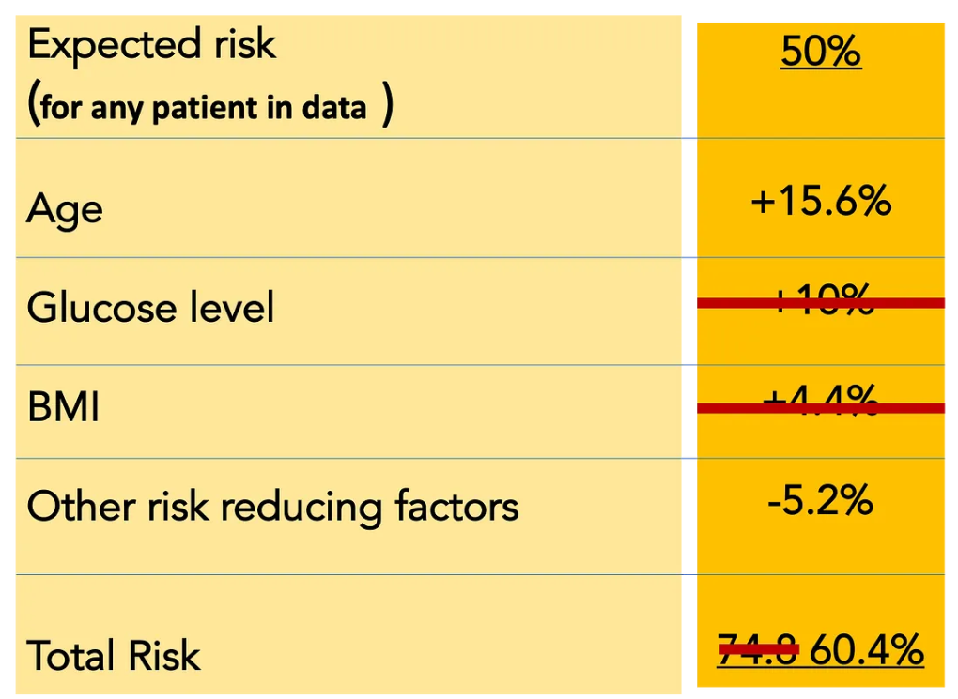
Example of SHAP:
Reference: https://towardsdatascience.com/top-5-techniques-for-explainable-ai-34349990cc83

Slide 9
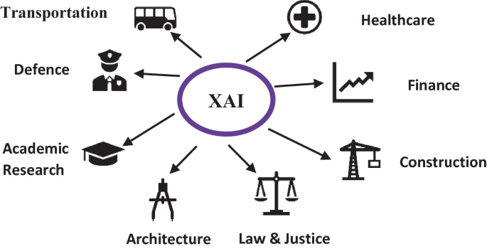
Conclusion

